Slide 1
Try to guess the programming languages

Slide 2
return false

Slide 3
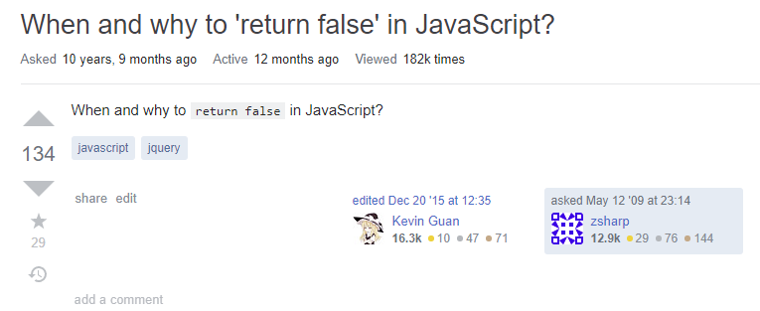

Slide 4
time.sleep

Slide 5
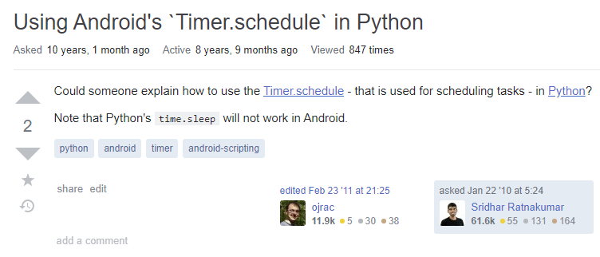

Slide 6
request token

Slide 7
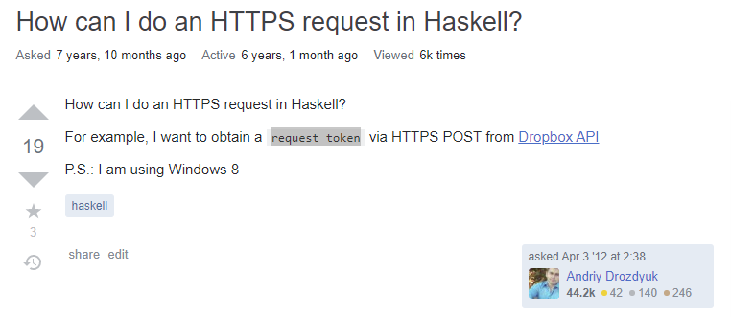

Slide 8
String [] stockArr = (String[]) stock_list.toArray();
String [] stockArr = {"hello", "world"};

Slide 9
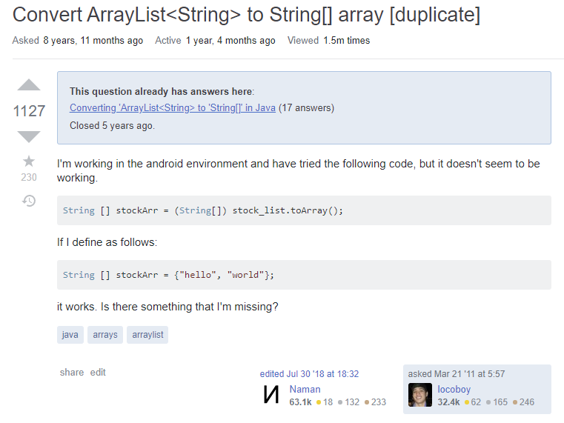

Slide 10
List<Order> objListOrder = new List<Order>();
GetOrderList(objListOrder); // fill list of orders

Slide 11
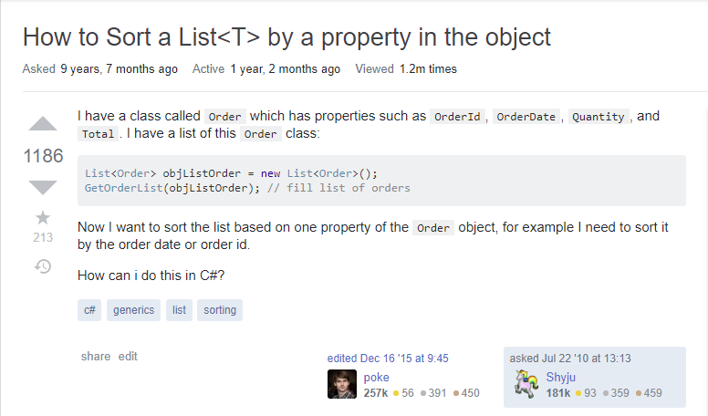

Slide 12
.push()
array.remove(number);

Slide 13
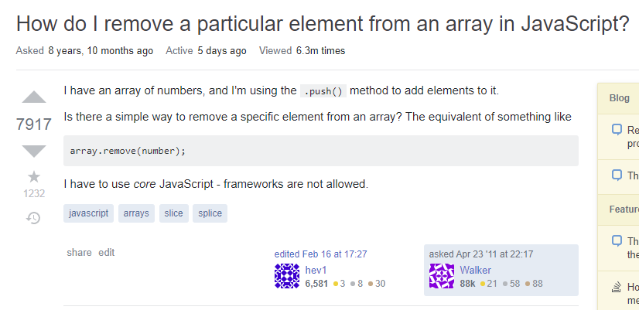

Slide 14
$a = 'How are you?’;
if ($a contains 'are’) {
echo 'true’;
}
if ($a contains 'are')

Slide 15
